Slide 1
Labor and Unions During Industrialization

Slide 2
Activity: Observe the following photographs and identify the different impacts industrialization on labor. While viewing each photograph think about the following:
Who is doing the work?
What are the hazards?
What type of work are they doing? Would they need training? (skilled vs. unskilled)
Think about these questions when you are looking at the pictures!
What was it like to live during this time period?

Slide 3
Working Conditions- What do you see?

Slide 5
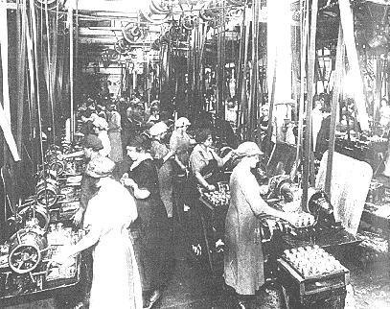

Slide 6
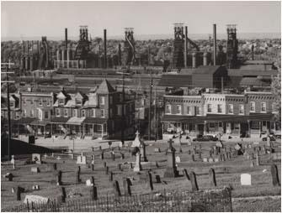
Every year approximately 200 miners per mine died. Here is an example of a cemetery where the industry that may have put them there in the background.

Slide 7
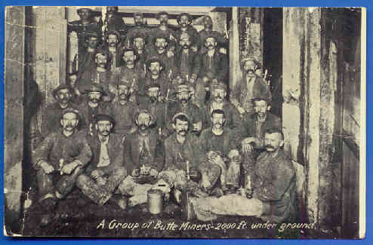
A group of miners pose for a picture……. 2000 feet underground!!!!! That is almost ½ of a mile!

Slide 8
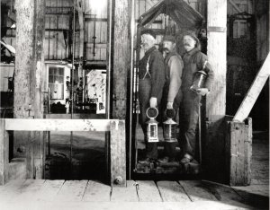
3 miners waiting to use the primitive elevator to lower them into the mining shaft for a days work!

Slide 9
Working Conditions
What did you see in the pictures?

Slide 10
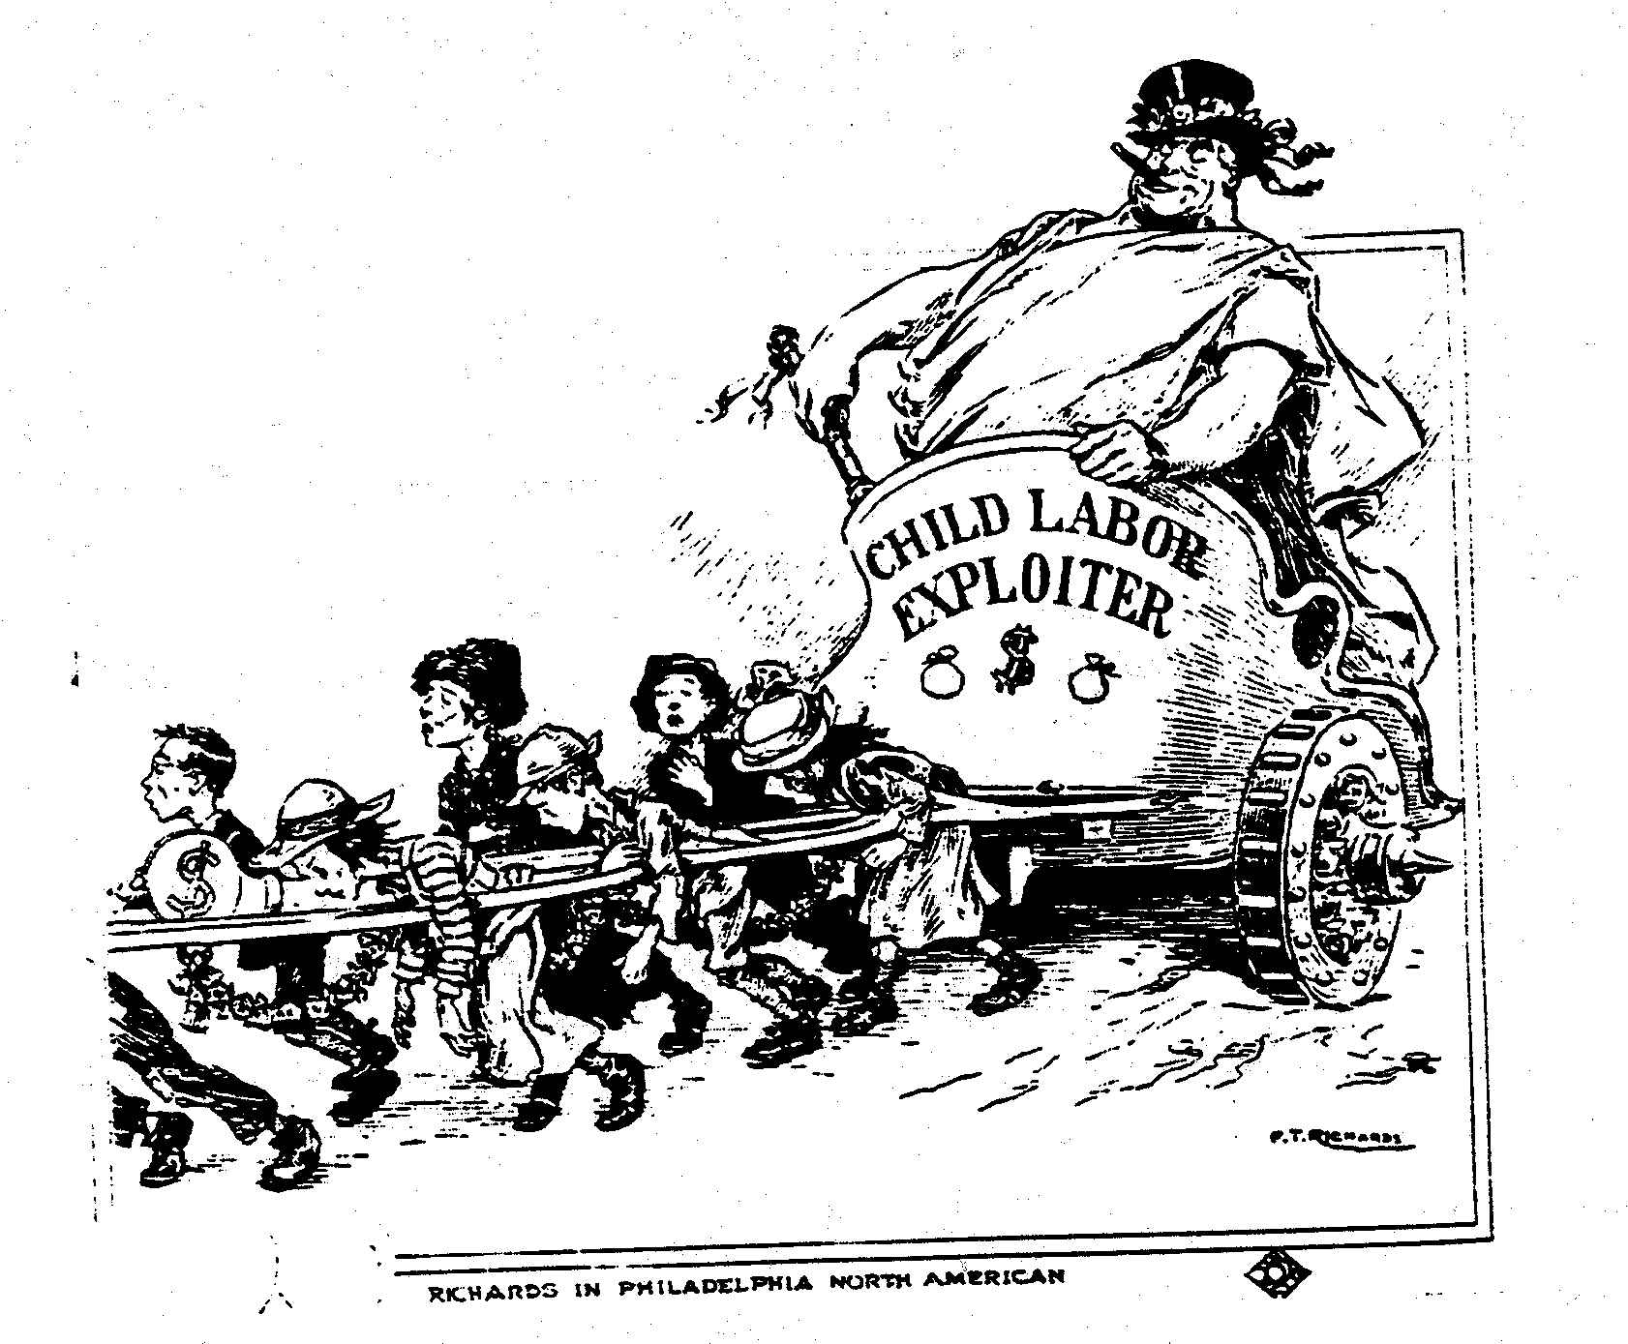
How is Big Business treating its workers according to the picture?

Slide 12
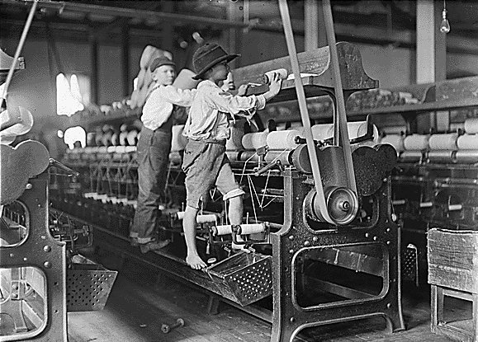
Children stand on the machine while it is in motion!!!!

Slide 13
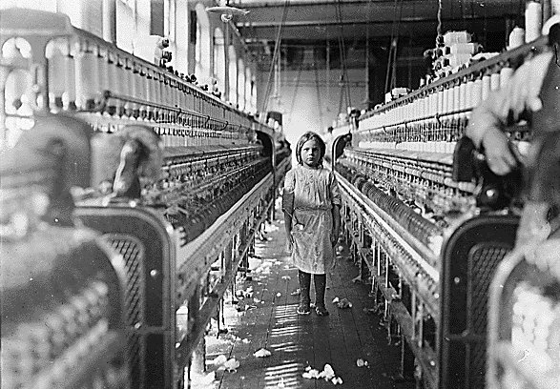
Here is a SIX year old girl working in a cotton mill

Slide 14
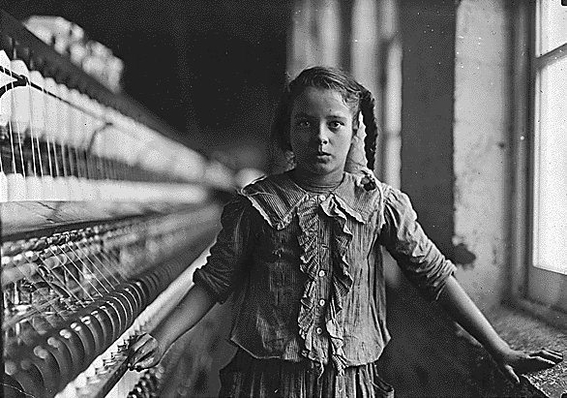
Look carefully, what is missing?

Slide 15
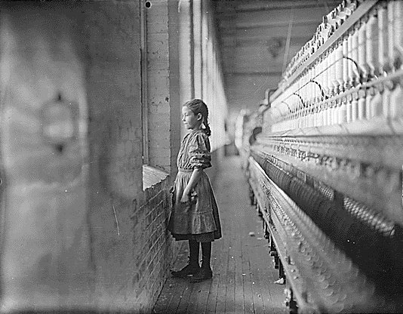
Daydreaming……. What is she thinking about?

Slide 16
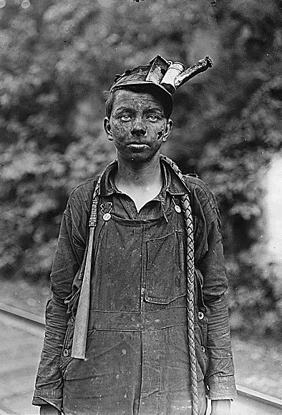
What occupational (job) hazards can you find in this picture?
A candle would be placed into his hat to provide light while working in the mines!

Slide 17
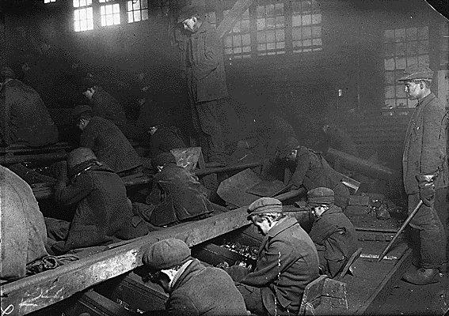
The taller boy standing to the right oversees the breaker boys who separate the coal from the stones during mining. The machine used is moving quickly and they are not allowed to wear gloves! Why might this be dangerous?

Slide 18
Women in the Workplace

Slide 19
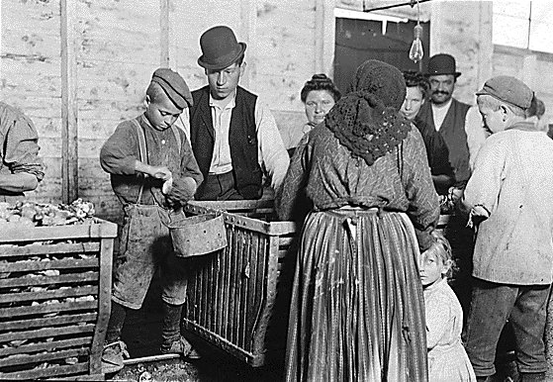
Mom and children working together in the seafood industry!

Slide 20
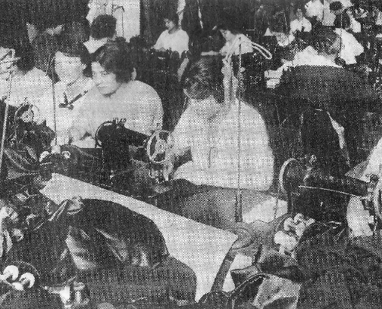
Women sewing in a garment factory.

Slide 21
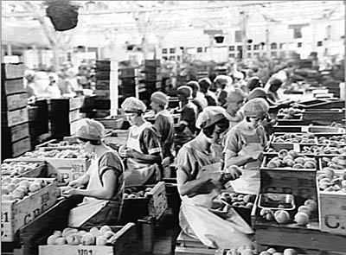
Women canning fruits in order to preserve them!

Slide 22
Women and Children in the Workplace – What do you see in the pictures?

