Slide 1
Landmark Supreme court cases
Civil Rights Era

Slide 2
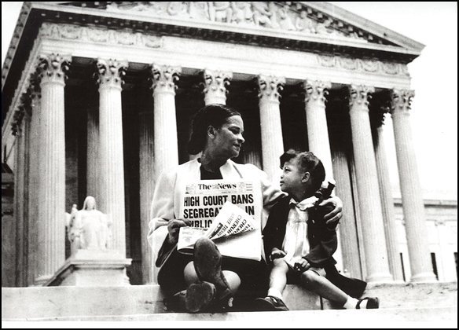
Brown v. Board of Education
What happened
Mr. Brown wanted his daughter to attend the neighborhood school (she was black and the school was for whites)
DECISION
Schools were desegregated. Separate is unequal. Separate but equal has no place
Integrated schools
Overturned Plessy v. Ferguson
14th Amendment (1954)

Slide 3
Swann v. CMS Board of Education
What happened
Mr. Swann said CMS was not integrated even though Brown v. Board of Ed said that segregation is not okay
DECISION
Court ordered busing to integrate schools
This decision changed the landscape of CMS schools by forcing the busing of students outside their neighborhood school
This lead to forced desegregation of schools
14th Amendment (1971)

Slide 4
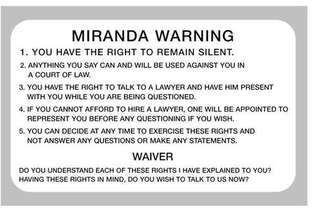
Miranda v. Arizona
What happened
Miranda arrested but not told his right to not confess to the crime, he signed a confession and was convicted
DECISION
A person must be read his or her rights before being arrested.
When Ernesto Miranda was arrested and questioned and signed a confession that listed that he had “full knowledge of his legal rights”, he was not made aware of his rights to counsel and the confession was illegally gained.
5th Amendment (1966)

Slide 5
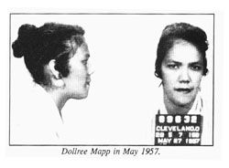
Mapp v. Ohio
What happened
Police searched Mapp’s house with a fake warrant and found illegal material
DECISION
Illegally obtained evidence cannot be used in court.
Illegal Evidence and Due Process Clause
No illegal search and seizures applied to all states
Before this rule not every state incorporated excluding evidence gained through an illegal search
Exclusionary Rule
4th and 14th Amendment (1962)

Slide 6
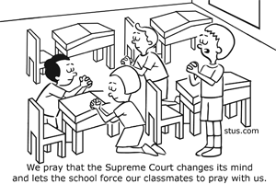
Engel v. Vitale
What happened
School board required students to say a prayer at beginning of each day
DECISION
A school cannot require students to pray. This court case upheld separation of church and state.
Establishment Clause
Eliminated prayers in school
Students cannot be forced to recite a prayer because it violates their 1st Amendment right to freedom of religion
1st Amendment (1962)

Slide 7
Regents of the University of California
What happened
A white student was not accepted in to the school and several minority students with lower scores were
DECISION
Schools cant use admissions quotas and admit students solely based on race
14th Amendment (1978)

Slide 8
Heart of Atlanta Motel v. US
What happened/Decision
Congress could outlaw racial segregation of private facilities that are engaged in interstate commerce
Supremacy Clause (1964)

