Slide 1
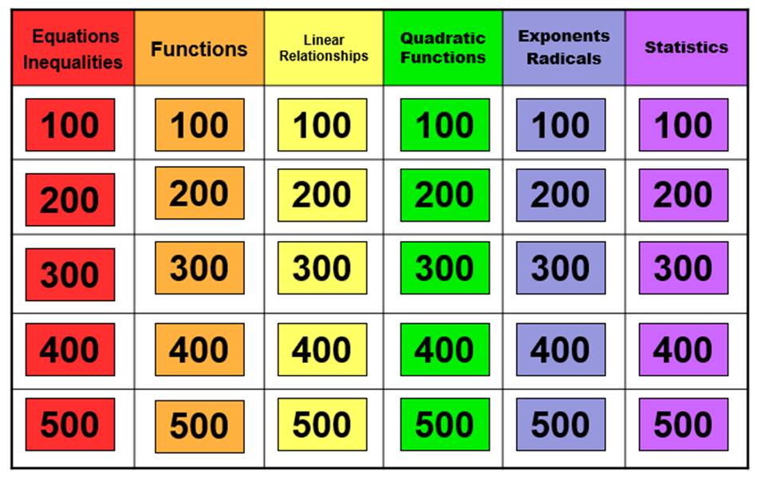
Algebra Jeopardy!

Slide 2
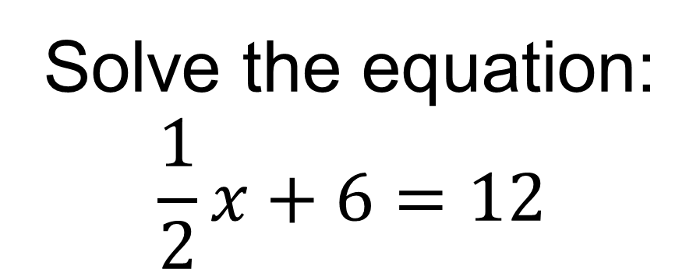
100
Answer: x = 12

Slide 3
200
Solve for x.
Answer: x< 0

Slide 4
300

Slide 5
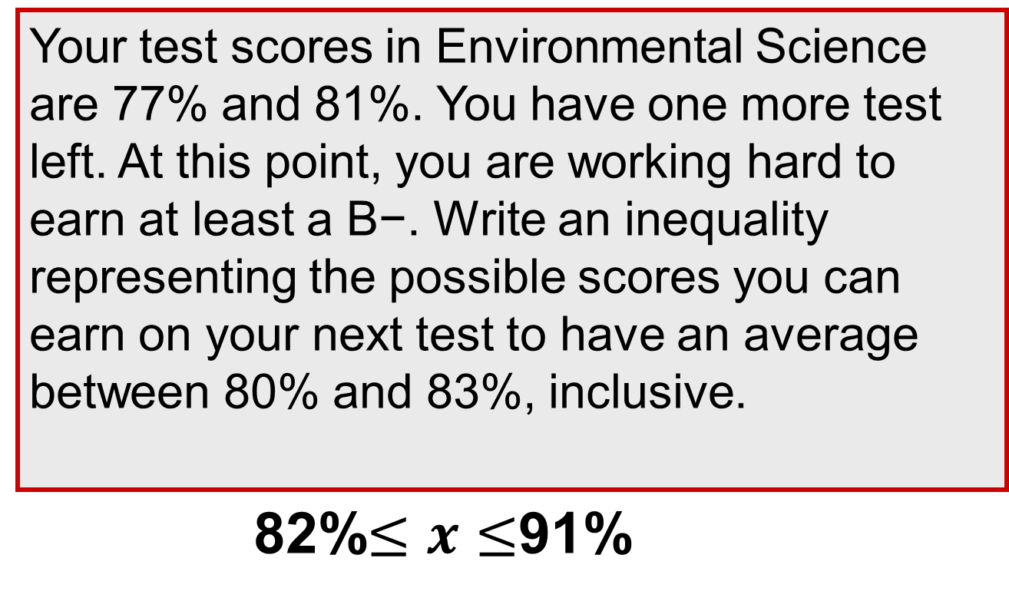
400
Answer: 82% < x < 91%

Slide 6
500
Solve for $x$.
$$rx−sx+y=z$$
Answer:$x=\frac{z−y}{r−s}$ or $x=\frac{y−z}{s−r}$

Slide 7
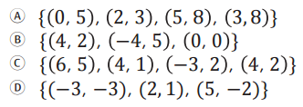
100.
Which of the following relations is not a function?
Answer: C

Slide 8
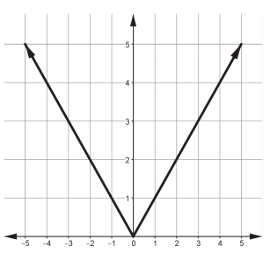
200
Identify the domain and range of the absolute value function.
Answer: D {all real numbers}, R y > 0

Slide 9
300.
Write an explicit and recursive formula for the sequence
10, 4, -2, -8
Answer:$a_{1}=10:a_{n}=a_{n−1}−6\text{ \& }a_{n}=16−6n$

Slide 10
400.
$$\text{Find} f\left(3\right) \text{for} f\left(x\right)=2^{3x−1}$$
Answer: $2^{8} \text{or} 256$

Slide 11
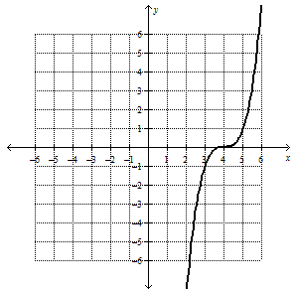
500
Write the equation for the function given the parent function is $f\left(x\right)=x^{3}$.
Answer:$f\left(x\right)={\left(x−4\right)}^{3}$

Slide 12
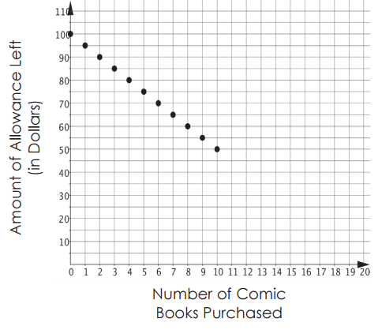
100..
What is the slope of the discrete function?
Click to view graph.
Answer: -5

Slide 13
200.
Determine the slope and y-intercept of $2x+5y=10$
Answer: slope $−\frac{2}{5}$ ; y-intercept 2

Slide 14
300..
.
Solve the system of equations:
$$x+y=4$$
$$x−y=6$$
Answer: (5,-1)

Slide 15
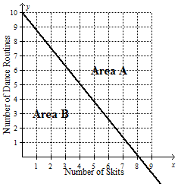
400..
The freshman class wants to include at least 120 people in the pep rally. Each skit will have 15 people, and the dance routines will feature 12 people. Which region of the graph would be shaded to represent the possible combinations of skits and dance routines at the pep rally? Click to view graph.
Answer: Area A

Slide 16
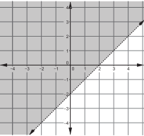
500..
Write the inequality for the graph.
Answer: $y≥x−2$

Slide 17
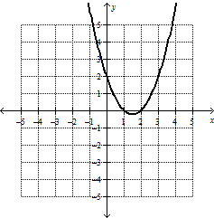
100…
Determine the zeros of the equation
Answer: 1 & 2;(1,0) & (2,0)

Slide 18
200…
Find the sum of
$$x^{2}+4x−7$$
and
$${3x}^{2}−8$$
Answer:${4x}^{2}+4x−15$

Slide 19
300…
.
What are the factors of
$${3x}^{3}−48x$$
Answer: $3x\left(x+4\right)\left(x−4\right)$

Slide 20
400…
When completing the square what value will need to be added to both sides of the equation?
$$x^{2}−14x+30=6$$
Answer:19 or 49

Slide 21
500…
Find the zeros of the equation
$${2x}^{2}+7x=9$$
Answer:$−\frac{9}{2} \& 1$

Slide 22
100….
Express $\sqrt[3]{x^{2}}$ in exponential form.
Answer: $x^{\frac{2}{3}}$

Slide 23
200….
Simplify
$${\left({2a}^{3}\right)}^{2}\left({5a}^{4}\right)$$
Answer: ${20a}^{10}$

Slide 24
300….
Determine the missing exponents for m and n
$$\frac{25m^{2}n^{3}}{5m^{?}n^{?}}=5m^{−3}n$$
Answer: 5, 2

Slide 25
400….
Convert $5^{\frac{1}{2}}∙5^{\frac{1}{2}}$ to an expression with a different base and a single fractional exponent.
Answer: ${25}^{\frac{1}{2}}$

Slide 26
500….
Solve the equation
$$2^{x+4}=2\sqrt{2}$$
Answer: $x=\frac{−5}{2}$

Slide 27
100…..
The following box plot shows student scores on the Unit 10 test. If there are 48 students represented, how many scored 70% or better?
Answer: 36

Slide 28
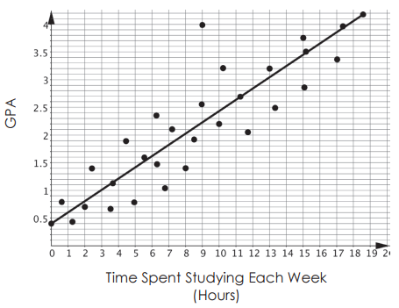
200…..
What does the slope of the line of best fit represent?
Click to view scatterplot.
Answer: For every hour spent studying the GPA increases 0.2

Slide 29
300…..
The data for Tampa temperatures in the month of July follow a normal curve. The mean temperature is 83° F and the standard deviation is 5.6° F. What is the temperature 1.5 standard deviations above the mean?
Answer: 91.4° F

Slide 30
400…..
Determine what percentage of girls, to the nearest tenth, participate in after school activities.
Answer:52.6%

Slide 31
500…..
Kayla’s quiz and test grades for 4th 9 weeks are 75%, 85%, 90%, 60%, 88% and 81%. If she earns a 83% on her next test, which of the following measures will change?
Mean
Median
Standard Deviation
Range
Interquartile Range
Answer: Mean, Standard Deviation

