Slide 1
MAFS.912.A-CED.1.1
MAFS.912.A-CED.1.Ap.1a: create linear, quadratic, rational, and exponential equations and inequalities in one variable and use them in contextual situation to solve problems.

Slide 2
Order of operations Vocabulary
Expression – a mathematical phrase with numbers and operation symbols.
Order of Operations – a set of rules for simplifying numerical expressions.
Parentheses – two curved lines used to enclose a quantity. In 2 x (3 + 1), the parentheses enclose 3 + 1.

Slide 3
Order of operations
The order of operations is a set of rules that tell you how to simplify a numerical expression. Anything in parentheses is always done first. A phrase such as, “Please Excuse My Dear Aunt Sally” will help you remember what to do first, next, and so on.
(Please) parentheses
5 + 7 x (6+4)
5 + 7 x 10
First, calculate inside the parentheses.
(Excuse) exponents
5 + 7 x 10
Second, find the value of the terms with exponents. There are none, so go on.
(My Dear) multiplication or division
5 + 7 x 10
5 + 70
(Aunt Sally)
addition or subtraction
5 + 70 = 75
Last, add.

Slide 4
order of operations practice
A mathematical expression has numbers and one or more operations. The expression 40 + 10 x 6 has two operations, addition and multiplication.
Which should you do first?
Activity: With a partner, simplify 6² + 24 – 7 x 3.
What did you do first? second? next? last?
Did your classmates get the same answers? Why or why not?
To make sure that everyone gets the same answers when we do problems like the one above, mathematicians established and agreed on the rule for order of operations.

Slide 5
Rules for order of operations
Work inside the parentheses before doing anything else.
Simplify and terms with exponents.
Multiply and divide from left to right.
Add and subtract from left to right.
Use the rules to simplify this expression: 6² + 24 – 7 x 3.
6² + 24 – 7 x 3 There are no parentheses, so do exponents first. 6² = 6 x 6 = 36
36 + 24 – 7 x 3 Next, multiply. 7 x 3 = 21 there is no division.
36 + 24 – 21
60 – 21
= 39

Slide 6
Expressions Vocabulary
Arithmetic Expression – an expression with numbers and operations.
Phrase – a group of words and symbols.
Algebraic Expression – a phrase containing variables as well as numbers and operations.

Slide 7
Expressions Vocabulary cont.
Variable – a quantity that can have different values.
Sum – the result of adding.
Difference – the result of subtracting.
Product – the result of multiplying.
Quotient – the result of dividing.

Slide 8
Expressions with variables
You just simplified an arithmetic expression! An arithmetic expression is a phrase that has numbers and operation symbols. An algebraic expression is a phrase containing numbers, operation symbols, and variables. A variable is something that can change. It usually is shown by a letter that stands for one or more numbers.
Activity: With a partner use the rules for the order of operations to simplify each expression:
80 ÷ 10 x 4 – 1
80 ÷ (10 x 4) – 1
(16 – 7) x (5 + 6)
(8 – 3)2 + 24 ÷ 3
8² ÷ 4 – 2 x 8
(12 – 3²) x 4 + 2
28 ÷ (4 + 3) x 9
(6 x 7 + 8) ÷ 2

Slide 9
Answers Expressions with variables
With your partner please review your answers and correct your work if needed:
31
1
99
18
0
14
36
25
Video Resource - Virtual Nerd: Click here

Slide 10
Class Activity Using Expressions with variables
Class Activity: Write an algebraic expression for each word phrase:
32 more than a
40 less than x
y divided by 9
the product of 25 and c
the quotient of 18 and n
8 Asian dinners increased by m Asian dinners
Use each of the numbers 3, 4, 5, and 6 once to make the sentence true.
_ + _ x ( _ - _ ) = 17
_ x ( _ - _ ) + _ = 19

Slide 11
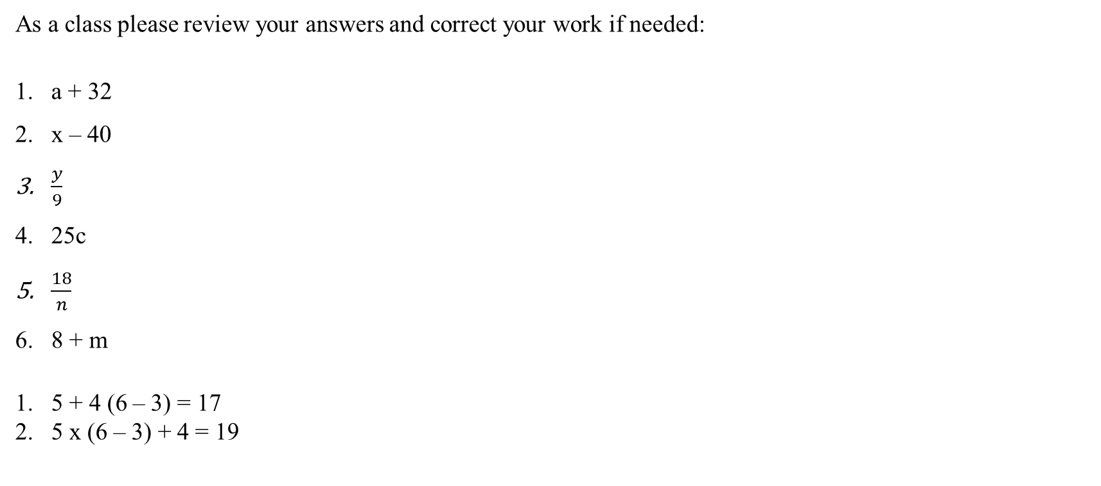
Activity Answers Expressions with variables
As a class please review your answers and correct your work if needed:
a + 32
x – 40
$\frac{y}{9}$
25c
$\frac{18}{n}$
8 + m
5 + 4 (6 – 3) = 17
5 x (6 – 3) + 4 = 19

Slide 12
Equations Vocabulary
Equation – a mathematical sentence stating that two quantities are equal. The expressions on both sides of the equals sign (=) have the same value.
Sentence – a group of words or symbols that express a complete idea.
Solve the Equation – find the values that make the equation true.

Slide 13
Equations Vocabulary Cont.
Subtraction Property of Equality – the property that says subtracting the same number from both sides of an equation does not change the equality.
Addition Property of Equality – a property that says adding the same number to both sides of an equation does not change the equality.
Inverse Operations – operations that undo each other.

Slide 14
Equations Vocabulary Cont. 3
Division Property of Equality – the property that says if two quantities are equal, dividing both quantities by the same nonzero number does not change the equality.
Multiplication Property of Equality – the property that says if two quantities are equal, multiplying both quantities by the same nonzero number does not change the equality.

Slide 15
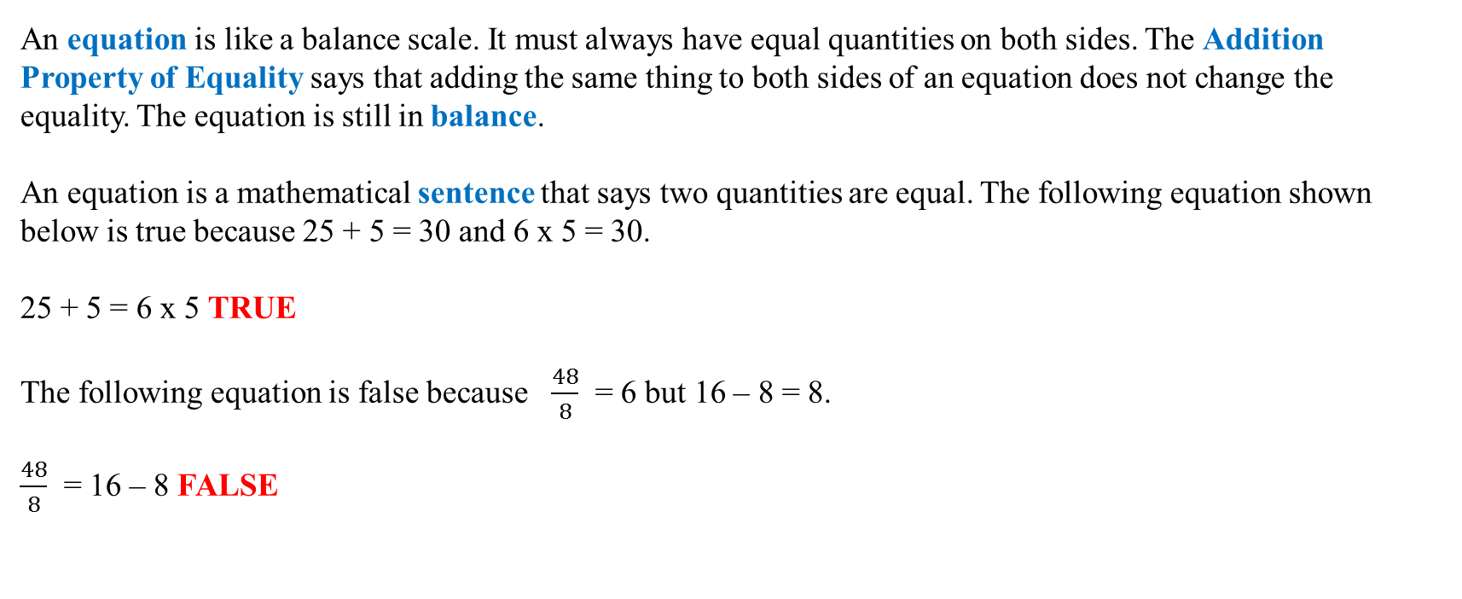
Solving equations
An equation is like a balance scale. It must always have equal quantities on both sides. The Addition Property of Equality says that adding the same thing to both sides of an equation does not change the equality. The equation is still in balance.
An equation is a mathematical sentence that says two quantities are equal. The following equation shown below is true because 25 + 5 = 30 and 6 x 5 = 30.
25 + 5 = 6 x 5 TRUE
The following equation is false because $\frac{48}{8}$ = 6 but 16 – 8 = 8.
$\frac{48}{8}$ = 16 – 8 FALSE

Slide 16
Solving equations by subtracting
To solve n + 38 = 82, you need to get the variable alone on one side of the equation. Because subtraction undoes addition, you can subtract 38 from the left side of the equation to get n alone. To keep the equation balanced, you must subtract 38 from the right side.
n + 38 = 82
n + 38 – 38 = 82 – 38 Subtract 38 from both sides.
n = 44 Compute.
Check: 44 + 38 = 82 If you get 44 for n then you got this problem right!
82 = 82 The solution makes the statement true.
This method works because of the Subtraction Property of Equality. It says that if two quantities are equal, subtracting the same number from both quantities does not change the equality.

Slide 17
Solving equations by Adding
To solve the equation m - 47 = 78, think about getting the variable m alone on one side of the equation. How can you undo subtracting 47? Because addition undoes subtraction, you can add 47 to the left side of the equation to get m alone. To keep the equation balanced, you must add 47 to the right side of the equation.
m - 47 = 78
m - 47 + 47 = 78 + 47 Add 47 to both sides.
m = 125 Compute.
Check: 125 - 47 = 78 If you get 125 for m then you got this problem right!
78 = 78 The solution checks.
You can use this method because of the Addition Property of Equality. It says that if two quantities are equal, adding the same number from both quantities does not change the equality.
To solve these equations, you can use the idea that subtraction undoes addition and addition undoes subtraction. Because they undo each other, addition and subtraction are inverse operations.
Video Resource – Math Antics (Part 1): Click here

Slide 18
Solving equations by Dividing
Multiplication and division are inverse operations because they undo each other. To solve the equation 15n = 120, divide the left side of the equation by 15. This undoes the multiplication and gets n alone. To keep the equality, you also must divide the right side by 15.
15n = 120 This means 15 times n equals 120.
15n ÷ 15 = 120 ÷ 15 Divide both sides by 15.
n = 8 Compute.
Check: 15 x 8 = 120 If you get 8 for n then you got this problem right!
120 = 120 The solution checks.
You can use this method because of the Division Property of Equality. It says that if two quantities are equal, dividing both quantities by the same nonzero number does not change the equality.

Slide 19
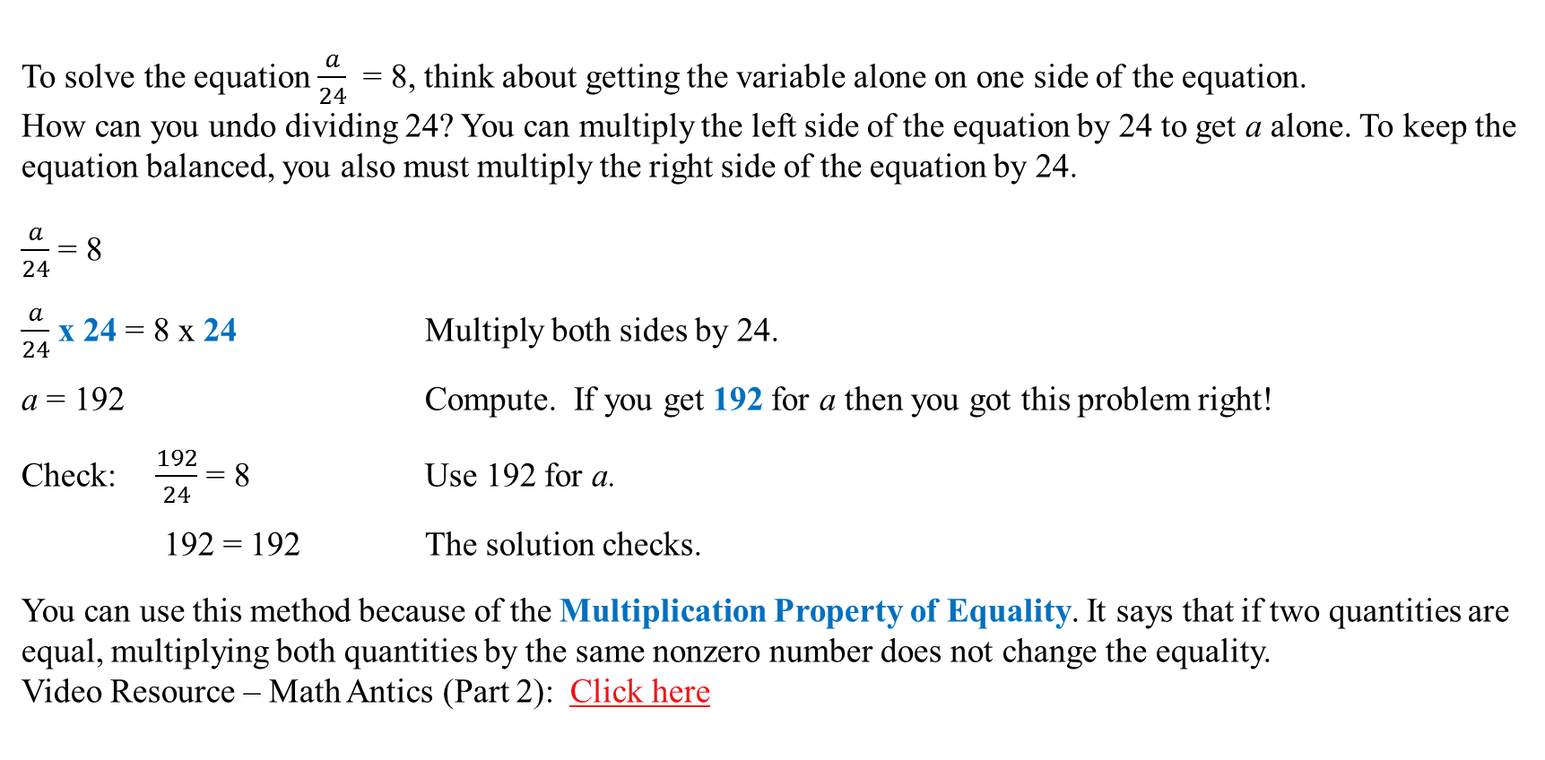
Solving equations by multiplying
To solve the equation $\frac{a}{24}$ = 8, think about getting the variable alone on one side of the equation.
How can you undo dividing 24? You can multiply the left side of the equation by 24 to get a alone. To keep the equation balanced, you also must multiply the right side of the equation by 24.
$\frac{a}{24}$ = 8
$\frac{a}{24}$ x 24 = 8 x 24 Multiply both sides by 24.
a = 192 Compute. If you get 192 for a then you got this problem right!
Check: $\frac{192}{24}$ = 8 Use 192 for a.
192 = 192 The solution checks.
You can use this method because of the Multiplication Property of Equality. It says that if two quantities are equal, multiplying both quantities by the same nonzero number does not change the equality.
Video Resource – Math Antics (Part 2): Click here

